Slide 1
Core Methods in Educational Data Mining
EDUC 6191 Spring 2024

Slide 2
Questions?
Before we start, any questions on anything?

Slide 3
Association Rule Mining
What is association rule mining?

Slide 4
Sequential Pattern Mining
What is sequential pattern mining?

Slide 5
Are SPM/ARM Causal?

Slide 6
Are SPM/ARM Causal?
No!

Slide 7
Today’s Class
The Land of Inconsistent Terminology

Slide 8
Association Rule Metrics
Support
Confidence
What do they mean?
Why are they useful?

Slide 9
Exercise
If a student took Advanced Data Mining, the student took Intro Statistics
Support?
Confidence?
Took Advanced DM | Took Intro Stat
1 | 1
0 | 1
0 | 1
0 | 1
0 | 1
0 | 1
1 | 0
1 | 0
1 | 0
1 | 0
1 | 1
Notes:
Support = 2/11 = 0.182
Confidence = 2/6 = 0.333

Slide 10
Questions? Comments?

Slide 11
Association Rule Metrics
Interestingness
What are some interestingness metrics?
Why are they needed?

Slide 12
Why is interestingness needed?
Possible to generate large numbers of trivial associations
Students who took a course took its prerequisites (Vialardi et al., 2009)
Students who do poorly on the exams fail the course (El-Halees, 2009)

Slide 13
Example: Cosine
Measures co-occurrence
P(A^B)
sqrt(P(A)*P(B))
Easy to interpret (numbers closer to 1 than 0 are better; over 0.65 is desirable)

Slide 14
Exercise
If a student took Advanced Data Mining, the student took Intro Statistics
Cosine?
Took Advanced DM | Took Intro Stat
1 | 1
0 | 1
0 | 1
0 | 1
0 | 1
0 | 1
1 | 0
1 | 0
1 | 0
1 | 0
1 | 1
Notes:
P(A) = 6/11 = 0.545
P(B) = 7/11 = 0.636
P(A^B) = 2/11 = 0.182
Cosine = 0.182/ SQRT(0.545*0.636)
Cosine = 0.182/0.589 = 0.309 = B

Slide 15
Example: Lift
Measures whether data points that have both A and B are more common than data points only containing B
Confidence(A->B)
P(B)
Easy to interpret (lift over 1 indicates stronger association)

Slide 16
Exercise
If a student took Advanced Data Mining, the student took Intro Statistics
Lift?
Took Advanced DM | Took Intro Stat
1 | 1
0 | 1
0 | 1
0 | 1
0 | 1
0 | 1
1 | 0
1 | 0
1 | 0
1 | 0
1 | 1
Notes:
Confidence (A->B) = 2/6 = 0.333
P(B) = 7/11 = 0.636
Lift = 0.333/0.636 = 0.524 = C

Slide 17
Example: Jaccard
Measures whether data points that have both A and B are more common than data points only containing B
P(A^B)
P(A)+P(B)-P(A^B)
Measures the relative degree to which having A and B together is more likely than having either A or B but not both

Slide 18
Exercise
If a student took Advanced Data Mining, the student took Intro Statistics
Jaccard?
Took Advanced DM | Took Intro Stat
1 | 1
0 | 1
0 | 1
0 | 1
0 | 1
0 | 1
1 | 0
1 | 0
1 | 0
1 | 0
1 | 1
Notes:
P(A) = 6/11 = 0.545
P(B) = 7/11 = 0.636
P(A^B) = 2/11 = 0.182
Jaccard = 0.182/(0.545+0.636-0.182)
Jaccard = 0.182/0.999 = 0.182

Slide 19
Association Rule Metrics
What do Merceron & Yacef argue? (from the reading)
Notes:
We argue in this paper that cosine and added value (or equivalently lift) are well suited to educational data, and that teachers can interpret their results easily.
We argue that interestingness should be checked with cosine first, and then with lift if cosine rates the rule as noninteresting.
If both measures disagree, teachers should use the intuition behind the measures to decide whether or not to dismiss the association rule.

Slide 20
Association Rule Metrics
What do Merceron & Yacef argue?
Cosine and lift are well suited to educational data, results can be easily interpreted
Cosine first. If non-interesting, then lift.
If measures disagree, domain experts (teachers) should use the intuition behind the measures to decide whether or not to pay attention to the association rule.
Notes:
We argue in this paper that cosine and added value (or equivalently lift) are well suited to educational data, and that teachers can interpret their results easily.
We argue that interestingness should be checked with cosine first, and then with lift if cosine rates the rule as noninteresting.
If both measures disagree, teachers should use the intuition behind the measures to decide whether or not to dismiss the association rule.

Slide 21
Association Rule Metrics
What do Luna-Bazaldua and colleagues argue? (from the video lecture)
Notes:
Lift and cosine are good indicators of interestingness. In addition, the Phi Coefficient, Convinction, and Jaccard also turn out to be good indicators of interestingness.

Slide 22
Association Rule Metrics
What do Luna-Bazaldua and colleagues argue?
Interestingness as evaluated by experts in context
Lift and cosine are good indicators of interestingness.
In addition, the Phi Coefficient, Conviction, and Jaccard also turn out to be good indicators of interestingness.
Notes:
Lift and cosine are good indicators of interestingness. In addition, the Phi Coefficient, Convinction, and Jaccard also turn out to be good indicators of interestingness.

Slide 23
Questions? Comments?

Slide 24
Any questions on apriori algorithm?

Slide 25
Let’s do an example
Volunteer please?

Slide 26
Someone pick
Support level = 0.7

Slide 27
Generate Frequent Itemset
ABCF ABDG ABEF BEGH
BDIJ BCDJ DEFJ ABCD DEGJ DEGJ ABCE ABCF
BCDJ BCDE DEFK DEGH

Slide 28
Was the choice of support level appropriate?
ABCF ABDG ABEF BEGH
BDIJ BCDJ DEFJ ABCD DEGJ DEGJ ABCE ABCF
BCDJ BCDE DEFK DEGH

Slide 29
Re-try with lower support
ABCF ABDG ABEF BEGH
BDIJ BCDJ DEFJ ABCD DEGJ DEGJ ABCE ABCF
BCDJ BCDE DEFK DEGH
BD, AB, BC, DE, DJ
J->D, E->D, D->E, D->J, B->D, D->B
BCD
CD->B, BC->D,

Slide 30
Generate Rules From Frequent Itemset
ABCF ABDG ABEF BEGH
BDIJ BCDJ DEFJ ABCD DEGJ DEGJ ABCE ABCF
BCDJ BCDE DEFK DEGH

Slide 31
Questions? Comments?

Slide 32
Differential Sequence Mining
What is the difference between differential sequence mining and regular sequential pattern mining? (Kinnebrew article)

Slide 33
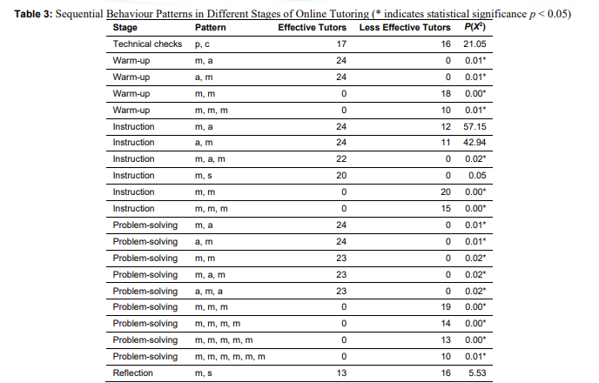
Example of differentiating sequences by group
(Cukurova et al., 2022)
Compared prevalence of sequences by group statistically

Slide 34
Questions? Comments?

Slide 35
Rules in Education
What might be some reasonable applications for Association Rule Mining, Sequential Pattern Mining, and Differential Sequence Mining in education?

Slide 36
Brainstorming activity
Get into groups of 3 and brainstorm on what ARM/SPM/DSM could be used for in education

Slide 37
Brainstorming activity
Let’s form into groups of 3 in breakout rooms and brainstorm on what ARM/SPM/DSM could be used for in education
Afterwards, please share some of your ideas

Slide 38
The End

